Slide 1
2023 legislative session
Laura Bordelon
Minnesota Chamber of Commerce

Slide 2
2023 legislative session
Single party DFL control
“Minnesota Miracle 2.0”
“I've said it before that you don't gain political capital to think about the next election… You gain political capital to burn it to improve lives. And Minnesotans know that this will do that.” – Governor Walz
“To Minnesotans who told us they are tired of gridlock and inaction, we heard you. We are leading and we are making a difference for Minnesotans.” – Senate Majority Leader Kari Dziedzic
“What I wanted us to do was under promise and over deliver. And I feel like that's what we did.” – House Speaker Melissa Hortman

Slide 3
2023 legislative session
LEGISLATURE AND GOVERNOR’S PRIORITIES:
Protect reproductive rights
Climate, clean energy and environment
Paid family leave
Earned sick and safe time
Protect workers
Protect democracy
Legalize marijuana
Gun control
Drivers’ licenses for undocumented individuals
Corporations and the wealthy pay their “fair share”
Health care mandates and cost control mechanisms
Tuition free college based on income; K-12 funding with automatic increases
Tax credits – income limited
Social security tax reduction – but not full elimination
“Historic investments” – housing, education, health care, transportation, wastewater treatment

Slide 4
2023 legislative session
OUR TAKE
Minnesota’s most consequential session in recent memory – “transformational,” “historic,” “landmark,” “bonkers!”
Long-term impacts unknown
Historic budget surplus drained; state spending blow out; $10 billion in new taxes; significant state government expansion
Unusually partisan approach given close split
Anti-business, anti-employer approach
No structural tax reform – missed opportunity
Notes:
Split state graphic

Slide 5
2023 legislative session
Budget setting session – Where we started
Historic budget surplus of $17.5 billion for FY 2024/25
7.4% spending growth of $3.8 billion, already assumed
Ongoing structural surplus of $5.4 billion for FY 26/27
7% spending growth of $3.87 billion, already assumed
State’s reserves and cash flow account at $3.2 billion
Notes:
52 billion for FY 24/25
59 billion for 26/27

Slide 6
2023 legislative session
Historic spending growth – Big picture
37% state General Fund budget increase of $19.3 billion = $71.5 billion in FY 24/25
On-going spending 17.5% growth in next biennium to $65 billion for FY 26/27
$1.5 billion on bottom line for FY 24/25
Had a $5.4 billion structural surplus in Feb. 2023 forecast – now projecting a $472 million in structural deficit for FY 26/27, with inflation = $1.36 deficit
Notes:
Change to graph instead of text
FY 22/23 budget was $52 billion. Under current law prior to 2023 session, the spending for FY 24/25 was projected to be $55.5 billion and for FY 26/27 was projected to be $59 billion – over 7% increase in spending. That already included inflation in spending of $3 billion for FY 26/27.
All funds spending is not known yet.

Slide 7
2023 legislative session
Historic spending growth – above base budgets
$2.5 billion Education with $3.3 billion on-going
$1.6 billion HHS with $1.4 billion on-going
$1.3 billion Human Services with $1.5 billion on-going
$650 million Higher Ed with $450 million on-going
$1.5 billion capital investment bonding plus $1 billion cash for projects
$1 billion General Fund transportation and $130 million General Fund on-going PLUS new tax increases/revenue
$1 billion Housing mostly one-time – includes workforce housing grants
$100 million broadband one-time, $300 million public safety aid one-time, $500 million Minnesota Forward Fund

Slide 8
2023 legislative session
TAXES – Nearly $10 billion in tax/fee increases (4-year tally)
$2.2 billion - Omnibus tax bill
$3.7 billion - Transportation bill
$2.8 billion - Paid leave mandate
$729 million - Housing bill
Net out tax decreases from tax bill – net tax increase of $4.5 billion
Tax bill negotiations:
Gov. $362 million; Senate $444 million and House $973 million
Final deal: $1.03 billion FY 24/25

Slide 9
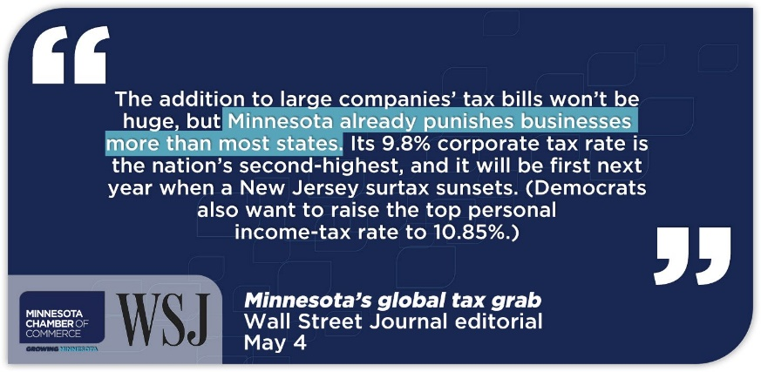
2023 legislative session
Tax increases (tax bill only)
Corporate tax increases: permanent
$430 million taxation of global income of GILTI with DRD of 50%, TY 23
$128 million dividends received deduction reduced from 80% to 50%, TY 23
$22 million net operating loss cap reduced from 80% to 70% TY 23
Individual tax increases: permanent
$85 million net investment income tax of 1% above $1 million (10.85% rate)
$354 million standard/itemized deduction speed up phase-out TY 23
Defeated: Worldwide mandatory combined reporting; 5th tier; capital gains 13.85%
Notes:
Corporate tax inclusion of GILTI, global intangible low-taxed income that was part of the 2017 federal tax cuts and jobs act. Effective tax year 2023. MN will go beyond most states in taxing this income as only 20 states include GILTI and we will be at high end of states that do tax this at all – for example NY only taxes 5% of GILTI income. MN will tax 50% of GILTI income – then apply MN corporate tax rate of 9.8%. Litigation is very likely as MN will be taxing income that is not earned in MN.
Corporate dividends received deduction (DRD) is reduced from 80% in current law to 50% and 40% depending on ownership levels effective tax year 2023. DRD is used to prevent triple taxation as it is a dividend paid by one company to another company.
NOL - Limits the amount of operating loss a corporation can claim in a year from current law 80% to 70% effective tax year 2024
Net investment income tax adding additional 1% tax on top of 9.85% rate for incomes above $1 million for effective tax year 2024. Net investment income includes interest, dividends, annuities, royalties, and other gains not derived from a trade or business and excludes gains from agricultural land sales. About 3,500 returns would be affected per year with average increase of $20,000. Effective tax year 2024
Standard/itemized deduction phase-out is accelerated for taxpayers in 4th tier rate effective (incomes over $300,000) for tax year 2023. An estimated 116,300 returns would have an average increase in tax of $1,494 per return. About 20,800 returns are over the $1 million threshold.

Slide 10
2023 legislative session
Tax rebates and credits (relief?)
$1.13 billion one-time rebate check tax = $260 single, $260 dependent ($75,000 income)
$893 million child tax credit $1,750 per child, phase-out at $35,000
$496 million partial social security exemption – $100K full, phase-out at $140K
$970 million increased spending/local government aid/property refund programs
Notes:
Walz checks- $1,000 checks for single filers with incomes under $75,000
$2,000 for married filers making under $150,000.

Slide 11
2023 legislative session
WORKPLACE MANDATES
Big mandates and changes
Earned sick and safe time = up to 2 weeks; fully paid through employer mandate. Begins Jan 1, 2024
Paid family and medical leave = 12 weeks + 12 weeks, capped at 20 weeks; partially paid through state run system; 0.7 percent payroll tax. Begins Jan 1, 2026
Pregnancy, nursing mothers’ accommodations, unpaid leave updates – no exemptions, no small business protections. Begins July 1
Complete ban on non-competes and restrictive franchise agreements. Begins July 1 and immediately for restrictive franchise agreements
Regulatory fines and penalties significantly increased and indexed for inflation (federal OSHA conformity). Begins September 1
Notes:
MN state OSHA plan – required to be same or greater than federal OSHA. This brings our penalties and fines up to fed level, and index them to inflation

Slide 12
2023 legislative session
WORKPLACE MANAGEMENT
Marijuana legalization
Legalized recreational use of marijuana; Begins August 1
Cannabis is now considered a “lawful consumable product” in Minnesota
Restrictions and guidelines for testing employees/job applicants for cannabis use

Slide 13
2023 legislative session
TRANSPORTATION
Surplus and General Fund dollars used for Transportation = $1 Billion (FY24-25); $130 Million (FY26-27)
Includes 100% dedication of auto parts to transportation (phased in by 2033)
Trunk Highway Bonding = $599M (FY24-26)
Transportation tax increases over four years = $3.8 Billion
0.75% metro area sales tax increase = $2 Billion, Begins October 1, 2023
Tab fee increases = $787 Million, Begins January 1, 2024
Gas tax indexing = $420 Million, Begins January 1, 2024
Motor vehicle sales tax increase = $214 Million, Begins July 1, 2023
50 cent per retail delivery over $100 = $190 Million, Begins July 1, 2024
Notes:
Gas tax increase equivalent to 3 cents in first year
After first index, limited to about 1-1.5 cents
Can never decrease
By 2027, expected to be 5 cents
Delivery fee exemption - non food items; medical supplies, baby supplies

Slide 14
2023 legislative session
TRANSPORTATION
Notable provisions
$194 Million for passenger train to Duluth
Funds state and local match for federal IIJA $; assistance for local communities applying for IIJA $
Climate change mitigation required for road and bridge expansion projects
Two crew members required on freight rail trains in/through MN
Metro transit safety improvement programs
Study to Extend Northstar Commuter rail to St. Cloud (from Big Lake)
Free transit fare pilot program
Task force to reform Met Council governance
Notes:
Any expansion or new construction required to complete climate change mitigation and vehicle miles travelled mitigation

Slide 15
2023 legislative session
HEALTH CARE
Six new health insurance mandates: $113M in increase in premiums in first year
Prescription Drug Affordability Board to set prices for certain drugs in MN
Public Health Care Program Expansions
Copays and out-of-pocket eliminated in Medicaid
MinnesotaCare Coverage for undocumented immigrants
Study Single Payer Plan for MN, January 2026
Sets us on path of MinnesotaCare Buy In / Public Option - anyone, at any income level, can join this public health care program, January 2027
Cost/Benefit analysis required for current health insurance mandates in statute
Notes:
Example of new health care mandate - open network for individuals with rare diseases (can go for treatment anywhere in country)
OOP = out of pocket

Slide 16
2023 legislative session
ENVIRONMENT
Money for IT upgrades and coordination for permitting needs
Cumulative impact reporting – state air permits. Considers past and current air, water, land pollution for state or federal air permits in environmental justice areas in seven county metro, Duluth and Rochester. Determined by Commissioner or 100 signatures on petition
Odor management – metro only
Air toxics reporting – metro only
Additional public meeting requirements for expiring air permits
Fees and fines for ground water appropriation permits
Notes:
Environmental justice area = poverty index, non English speaking, minority population. Federal definition.
Odor management – if 10 calls within 48 hours, and odor is “hurting the enjoyment of life”
Air toxics reporting adds 5 more criteria to obtain permit.
Farmers, cities, golf courses affected by ground water appropriations

Slide 17
2023 legislative session
ENVIRONMENT
PFAS
11 products banned by 2025; reporting requirement for all products starts in 2026; complete ban of all products by 2032
Exempts medical devices – but must register and pay fee
2nd state in the nation to enact a ban
Notes:
11 products banned first – textiles for homes and businesses (drapery floor coverings, furnishings, bedding, towels, tablecloths), ski wax, cosmetics, dental floss, menstrual products,
ME is only other state with such aggressive approach – but they pushed their reporting date to 2026 and est stakeholder group to decide; complete ban by 2027
Possible federal pre-emption for national defense purposes

Slide 18
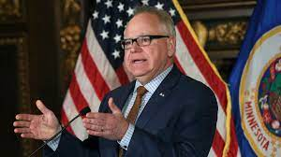
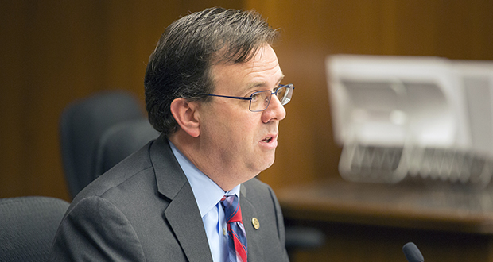
2023 legislative session
2023 Legislative Session
“This changes Minnesota from a centrist state to hard left. We had politics that skewed sometimes center right, sometimes center left. But this, whether you call it progressive or ambitious or just extreme, it is outside the norm of what I always thought of as Minnesota's sort of deliberative temperament and centrist culture.” – Rep Pat Garofalo
Minnesota transformed itself from a cold, agrarian state into a national leader decades ago… “Because we were willing to take risks, to do things differently. We're doing that again.” – Governor Walz

Slide 19
2023 legislative session
Laura Bordelon
Minnesota Chamber of Commerce

